Slide 1
UP ELECTIONS 2017 SENTIMENTAL ANALYTICS AND PREDICTION

Slide 2
PROJECT OVEREVIEW
This project included downloading twitter data into R and performing analysis. The steps involved are: • Organizing the data and removing Stopwords, punctuations • Creating a glossary to monitor Hindi and English words • Structuring barplots and Wordcloud to identify the most commonly used words • Identifying positive and negative words and drawing trend lines to realize their usage and rate of recurrence in twitter data • Preparing a report on the conclusion and forecasting a winner based on the analysis

Slide 3
ELECTION LANDSCAPE
Following parties were included for the election landscape as they play a pivot role in elections:
Bharatiya Janata Party(BJP)
Indian National Congress+ Samajwadi Party (INC+SP)
Bahujan Samaj Party (BSP)
Predictions are made by analyzing approx. 20K tweets all taken together at various instance of time.

Slide 4
R-ANALYSIS

Slide 5
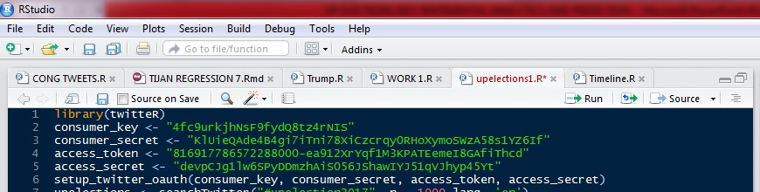
Setting Twitter Authentication
A twitter application by the name of “ ” was created and the necessary keys were generated. Using the R package “twitteR” we set up the necessary authentications for importing the twitter data into R environment.

Slide 6
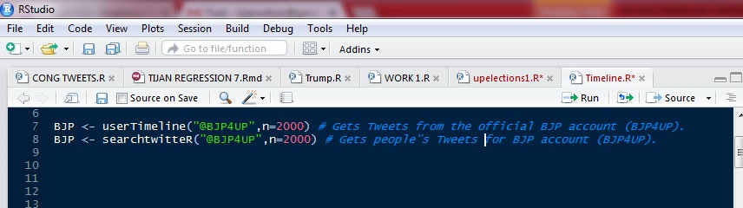
IMPORTING TWEETS :

Slide 7
CLEANING THE DATA :

Slide 8
WORDCLOUD CREATION :

Slide 9
SENTIMENTAL SCORES :

Slide 10
TRENDLINES :

Slide 11
WORDCLOUD RESULTS

Slide 12
UP ELECTIONS :
This maps the sentimental shifts in the public perception for the UP Elections, indexed under #UPElections2017 and #UPPolls. Tweets are collected at differing intervals and their wordclouds are created. The following slides will contain the word clouds.

Slide 13
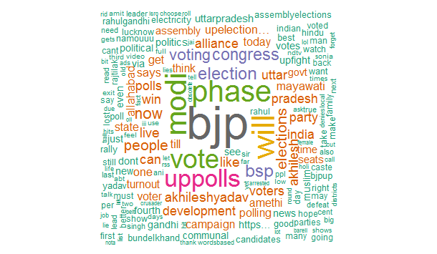
#UPElections2017
From the above word cloud, we see that “bjp” was the most frequently used string, which is indicative of people’s perception toward BJP and the fact that UP Elections and BJP have a prominent hold on people’s psyche. ‘modi”was also frequently mentioned in the tweets.

Slide 14
TRENDLINES :

Slide 15
BJP :
This maps the sentimental shifts in the public perception for BJP, during the UP Elections, indexed under #BJP4UP. Also, mapped are the sentiments of the face bearer of BJP , PM Narendra Modi by analyzing @narendramodi(official twitter account of PM Modi). Tweets are collected at differing intervals and their word clouds are created. The following slides will contain the word clouds.

Slide 16
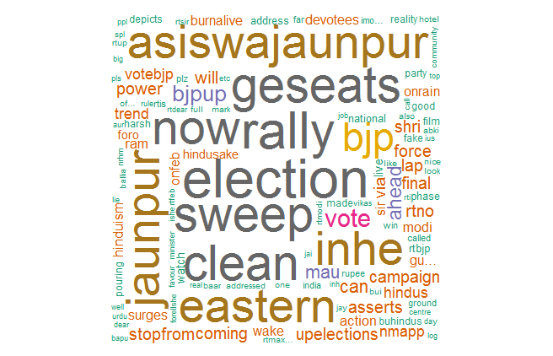
#BJP4UP
From the above word cloud we see that all the tweets indexed under, #BJP4UP reflects a high confidence regarding their chances in the ongoing election, as the words “election” and“sweep” are quite prevalent.

Slide 17
TRENDLINES :

Slide 18
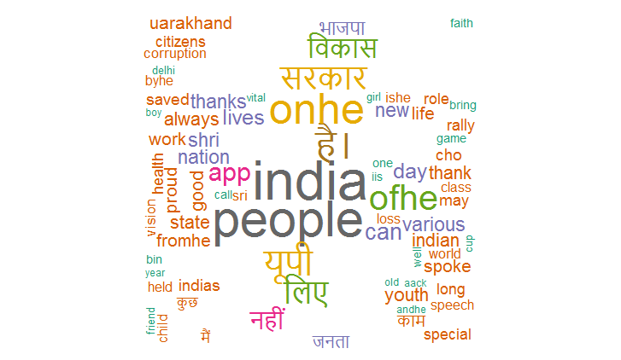
@narendramodi
From the above word cloud, we see that PM Modi is concerned about the country in general, as the strings “india” and “people” are the most prevalent. However, we see that he is also quite involved in the happenings of UP Elections 2017.

Slide 19
TRENDLINES :

Slide 20
SAMJWADI PARTY :
This maps the sentimental shifts in the public perception for the UP Elections, indexed under #UPElections2017 and #UPPolls. Tweets are collected at differing intervals and their wordclouds are created. The following slides will contain the word clouds.

Slide 21
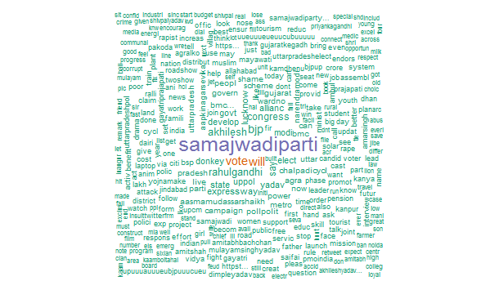
#AKHILESH YADAV:

Slide 22
TRENDLINES :

Slide 23
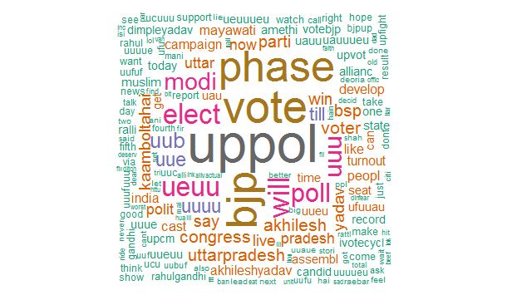
#SAMAJWADI PARTY:

Slide 24
TRENDLINES :

Slide 25
BSP :
This maps the sentimental shifts in the public perception for the UP Elections, indexed under #UPElections2017 and #UPPolls. Tweets are collected at differing intervals and their wordclouds are created. The following slides will contain the word clouds.

Slide 26
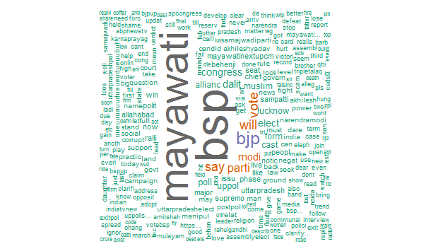
#BSP :

Slide 27
TRENDLINES :

